Slide 1

The Impact of Financial Aid & Tuition on Student Enrollment

Slide 2
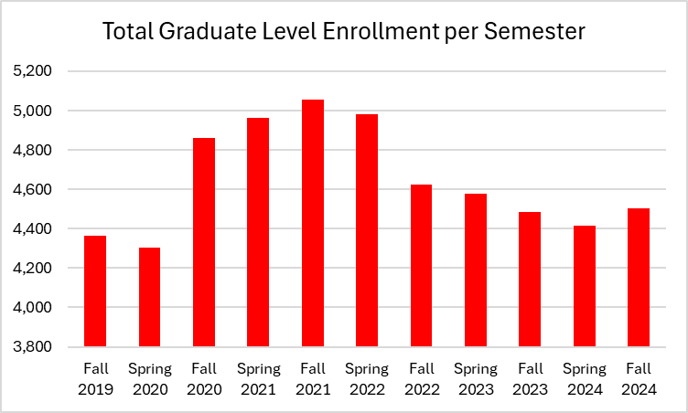
The Challenge: Graduate Enrollment Trends
Students states that cost is a primary decision factor with 76% students report financial aid influenced their choice and would switch for $5,000 more.

Slide 3
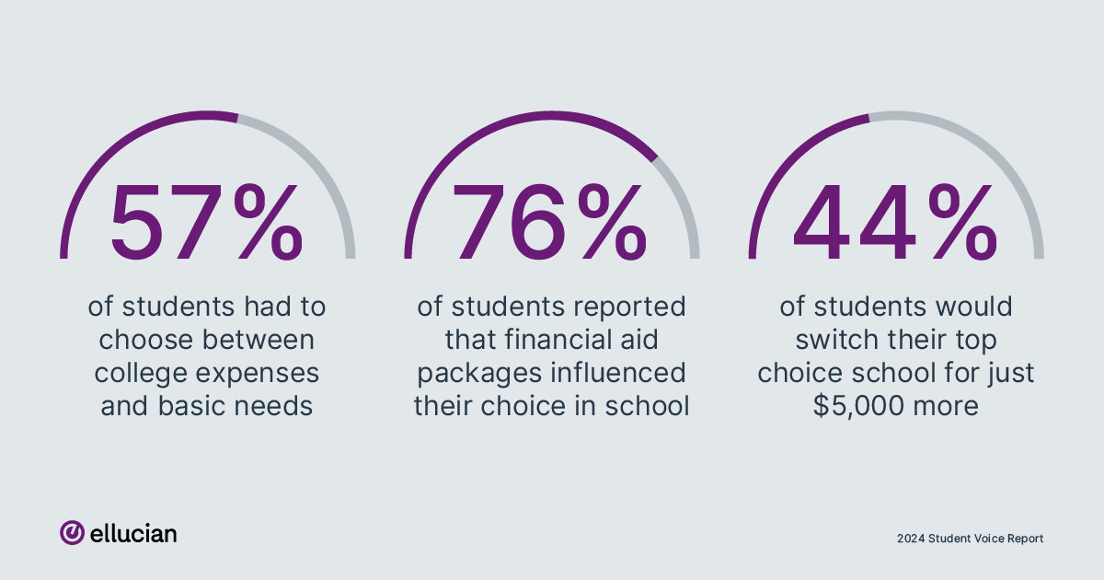
Important Factors in Choosing a School
Notes:
https://www.prnewswire.com/news-releases/national-survey-reveals-59-of-college-students-considered-dropping-out-due-to-financial-stress-nearly-80-report-negative-impact-on-mental-health-302182593.html

Slide 4
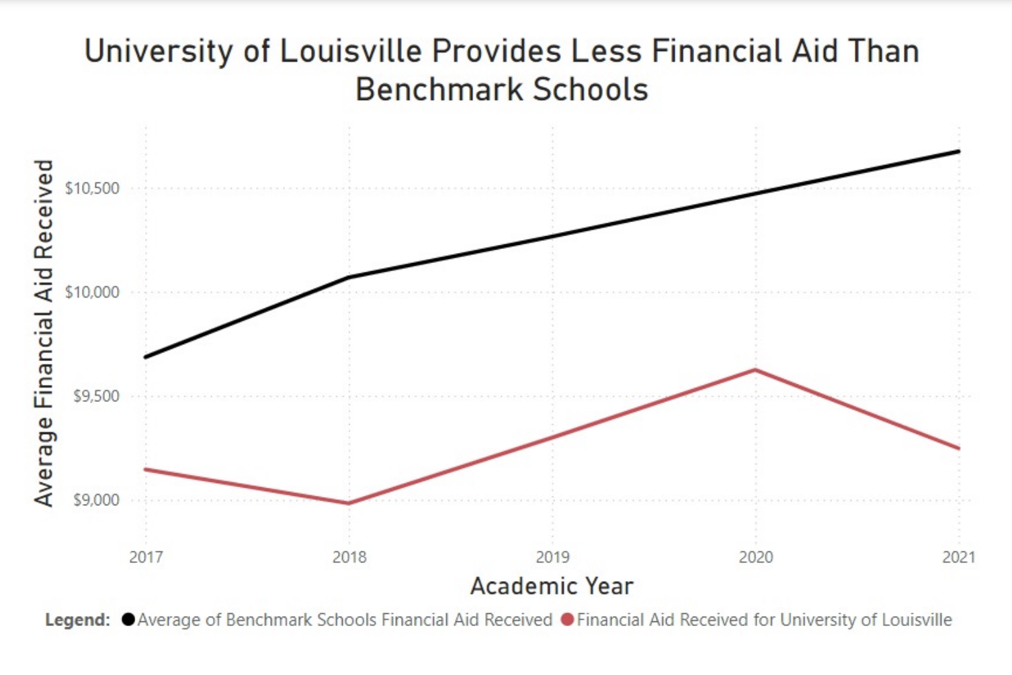
Benchmarking: UofL's Financial Aid Gap
From 2017 to 2021, UofL provided consistently less average financial aid compared to benchmark schools

Slide 5
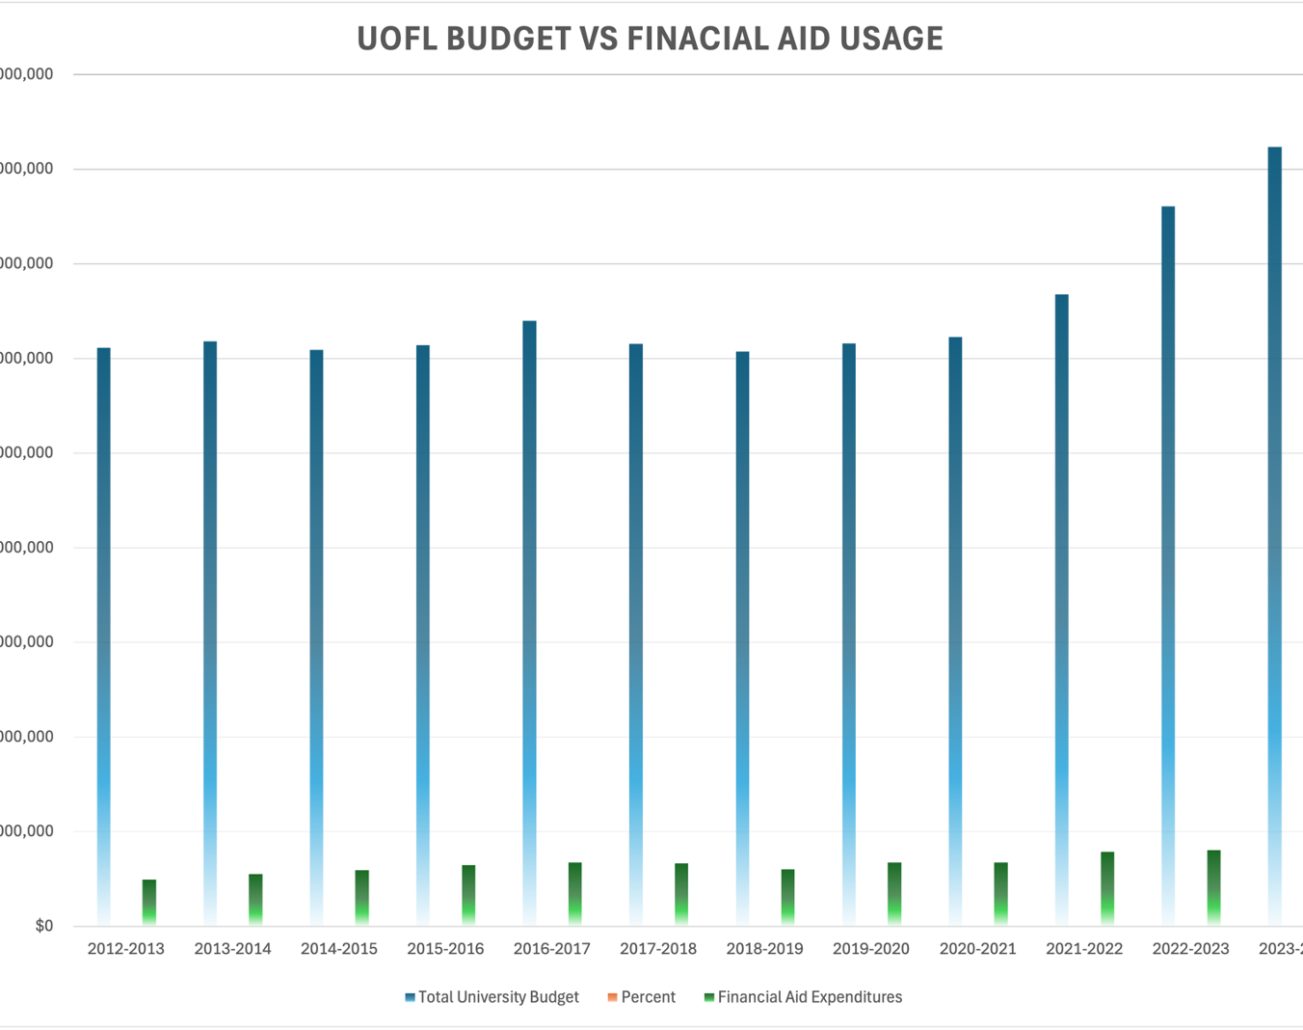
Budget Allocation: Financial Aid Expenditures vs. Total Budget
While the total university budget has grown significantly since 2012, Financial Aid Expenditures remain a small percentage of the total budget

Slide 6
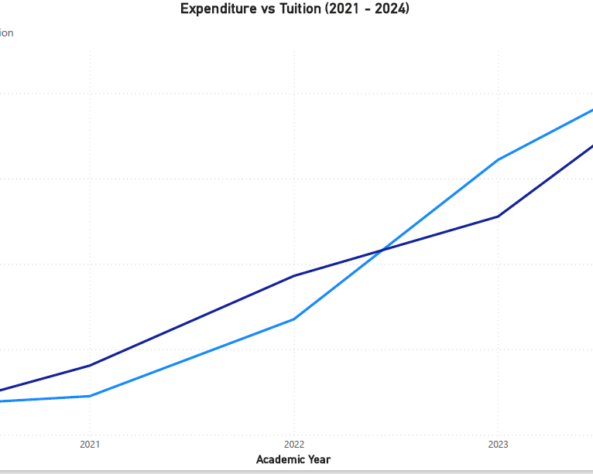
The Result: Rising Expenditures Drive Tuition Increases
Rising university expenditures closely track the increase in tuition costs from 2020-2024

Slide 7
Reversing the Trend And Prioritizing Student Support
increase the percentage of budget allocated to aid
Tuition Strategy & Cost Control
Improve communication of existing support
Develop targeted aid packages

Slide 8

QUESTIONS?

